Slide 1


Data Exploration
Notes:
Data exploration is the initial step in data analysis, where the user examines the data to get an understanding of the data and to find patterns. In this presentation, various methods for data explorations are introduced and their implementation in R is discussed.

Slide 2
Data Exploration
Data exploration refers to a set of procedures and methods that allows a data modeler to have a better understanding of the underlying data.
In this presentation, we consider two types of data exploration techniques:
Data exploration methods that are based on descriptive statistics
Data exploration methods that are based on visualization methods
Notes:
Data exploration is the initial step in data analysis, where users explore a large data set in an unstructured way to uncover initial patterns, and to find and understand the characteristics of the data. This process is not meant to reveal every bit of information in a dataset, but rather, it helps create a broad picture of important trends and major points to study in greater detail.
Data exploration can use a combination of descriptive statistics and data visualization methods. Many times, data exploration uses visualization because it creates a more straightforward view of data sets than simply examining thousands of individual data points.
This process makes deeper analysis easier because it can help target future searches and begin the process of excluding irrelevant data points and modelling routes that may turn up no results. More importantly, it helps build a familiarity with the existing information that makes finding better answers much easier.

Slide 3
Data Exploration: Descriptive Statistics
As mentioned earlier, descriptive statistics can reveal very useful insights about the data.
For numerical variables, common descriptive statistics measures include mean, standard deviation, quartiles and the median.
Frequency tables are commonly used for categorical variables. Frequency tables can be applied to the variables individually or by considering two variables (i.e. two-way frequency tables)
Notes:
As we have seen earlier, descriptive statistics can reveal very useful insight about the data. For numerical variables, common descriptive statistics include the mean, the standard deviation, the quartiles, and the median of the data. Frequency tables are commonly used for categorical variables. Frequency is a measure of the number of occurrences of a particular value in a given dataset. A frequency table is a method of organizing raw data in a compact form by displaying a series of values together with their frequencies.

Slide 4
Example: summary() function
summary(Wage)
## year age maritl race ## Min. :2003 Min. :18.00 1. Never Married: 648 1. White:2480 ## 1st Qu.:2004 1st Qu.:33.75 2. Married :2074 2. Black: 293 ## Median :2006 Median :42.00 3. Widowed : 19 3. Asian: 190 ## Mean :2006 Mean :42.41 4. Divorced : 204 4. Other: 37 ## 3rd Qu.:2008 3rd Qu.:51.00 5. Separated : 55 ## Max. :2009 Max. :80.00 ##
Notes:
As its name implies, the summary function in R is an efficient way of calculating the summary of the whole data frame. For numerical variables, the summary function calculates the minimum, the first quartile, the median, the mean, the 3rd quartile, and the maximum value of the data. For categorical variables, the summary function provides the name of all the levels, and the frequency of their occurrence in the data frame. Lets consider an example in here. Here we are looking at the wage data frame. The variables that are printed are year, age, marital status, and race. Year and age, as we can see, the quartile value, plus the mean value are shown. But as for marital status and race, which are categorical variables, we can see that the levels are printed, as well as the number of occurrences of each of the levels in the data frames.

Slide 5
sapply( ) Function
sapply( ) is a function can be used to apply a given function to all columns of a data frame in an efficient and elegant fashion.
Imagine that you want to calculate the standard deviation of the year, age, logwage and wage columns of the Wage dataframe.
We can first select these columns from the Wage dataframe using the select() function from the dplyr and the use sapply to calculate the standard deviation of all columns
The alternative solution was to use the summerise( ) function and list all variables explicitly (which can be tedious when there are too many columns )
Notes:
The “saaply” is an interesting function that can be used to apply a given function to all columns of a data frame. The function allows crossing the data in a number of ways, and avoids an explicit use of __________ which can save time for computation as well as code development. Imagine that we want to calculate the standard deviation of the year, age, log of the wage and wage column in the wage data frame. In this case, you can first select these columns from the wage data frame using the select function from the dplyr and then use the “sapply” to calculate standard deviation. Of course we can use the summarize function as well, but in that case, we need to explicitly name all the variables, which is tedious.

Slide 6
Example: sapply( ) Function
library(ISLR)
library(dplyr)
Temp=Wage[c("year","age","logwage","wage")] sapply(Temp,sd) # Apply sd() function to all columns
## year age logwage wage ## 2.0261673 11.5424056 0.3517526 41.7285955
Wage %>% select("year","age","logwage","wage") %>% sapply(sd) #more efficient
## year age logwage wage ## 2.0261673 11.5424056 0.3517526 41.7285955
Notes:
Let’s examine the R implementation here. So first, we need to call the ISLR dplyr libraries. After that we can explicitly specify the columns of interest as year, age, log of wage, and wage, and select those columns from the wage data frame. You can store this in an intermediate variable called “temp” and then we can use the supply function to calculate SD for all the columns of the temp. in this case we can see the “sapply” temp is the input and the SD is the function which would be applied to every column of the temp variable. The results are printed here, so for example for the year, we can see that the standard deviation is 2.02. the more efficient way of doing this is to avoid creating the temp variable. We can use the piping as we discussed before. In this case wage will be passed through the select function, using the pipe operator and the select function will select the year, age, log of wage, and wage variables. The results will then be passed to the “sapply” function, again using the piper operator for the standard deviation or SD function applied to every column of the result.

Slide 7
Two-way Frequency Tables
For categorical variables, as we have seen, univariate frequency tables can be complied using the summary( ) function.
In many cases, we might want to examine the frequency distribution of one categorical variable with regards to another variable.
Table ( ) is a function that can be used to compile Two-way Frequency Tables
Example: Show the breakdown of the health insurance status of individuals (univariate table). Show the same by additionally considering the martial status (two-way table)
Notes:
Two-way frequency tables are a visual representation of the possible relationships between two sets of categorical data. The categories are labeled at the top and the left side of the table, with the frequency information appearing in the interior cells of the table.

Slide 8
Example
summary(Wage$health_ins)
## 1. Yes 2. No ## 2083 917
table(Wage$health_ins)
## ## 1. Yes 2. No ## 2083 917
table(Wage$health_ins, Wage$maritl)
## ## 1. Never Married 2. Married 3. Widowed 4. Divorced 5. Separated ## 1. Yes 395 1488 14 151 35 ## 2. No 253 586 5 53 20
Notes:
Here is an example. As discussed, if we are interested in the univariate frequency table for any particular column we can use the summary function. In this case, we are interested in understanding how many of the individuals in the dataset have health insurance. So we can say summary wage$healthinsurance. As we can see out of the 3000 individuals in the dataset, 2,083 individuals have health insurance and 917 individuals do not have any health insurance. We can also use table function for the univariate frequency table as well. However, the table function is even more useful when we are interested in understanding the 2 way frequency tables. In this example we are interested in seeing how many individuals have health insurance by considering their marital status as well. So table wage$healthinsurance comma wage$maritl gives us exactly the two frequency table for health insurance and marital status. So, as we can see, among the never married population, 395 individuals have health insurance, while 253 individuals do not have health insurance. The frequencies are also shown for married, widowed, divorced, and separated individuals.

Slide 9
Data Visualization
Data visualization comes with several key advantages, including the followings:
It allows users see several different perspectives of the data.
It makes it possible to interpret vast amounts of data
It offers the ability to note exceptions in the data.
It allows the user to analyze visual patterns in the data.
So far, we have examined some basic visualization methods such as histogram, scatterplots plot, boxplot, and correlation plot.
Notes:
Data visualization techniques are widely used during the data exploration phase. Data visualization tools can help us better understand the data, and get a good understanding of the patterns that may exist in the data. They are also useful for spotting invalid data and exceptions, such as outliers that may exist in the data. So far we have examined some basic visualization methods such as histograms, scatterplots, boxplots, and correlation plots.

Slide 10
Example
library(ISLR)
## Warning: package 'ISLR' was built under R version 3.4.4
summary(Carseats)
## Sales CompPrice Income Advertising ## Min. : 0.000 Min. : 77 Min. : 21.00 Min. : 0.000 ## 1st Qu.: 5.390 1st Qu.:115 1st Qu.: 42.75 1st Qu.: 0.000 ## Median : 7.490 Median :125 Median : 69.00 Median : 5.000 ## Mean : 7.496 Mean :125 Mean : 68.66 Mean : 6.635 ## 3rd Qu.: 9.320 3rd Qu.:135 3rd Qu.: 91.00 3rd Qu.:12.000 ## Max. :16.270 Max. :175 Max. :120.00 Max. :29.000
Notes:
Let’s consider a few visualization examples here. For this example, we will be using the car seats data frame, which is a part of the ISLR package. The car seat dataset contains sales of child car seats at 400 different stores. So let’s examine the variables included in the dataset. The first variable is “sales”, which is the unit sales in thousands at each location. The “comprice” is the price charged by the competitor at each location, we also have the income which refers to the community income level in thousands of dollars. Advertising refers to the local advertising budget for the company at each location in thousands of dollars.

Slide 11
Example
## Population Price ShelveLoc Age ## Min. : 10.0 Min. : 24.0 Bad : 96 Min. :25.00 ## 1st Qu.:139.0 1st Qu.:100.0 Good : 85 1st Qu.:39.75 ## Median :272.0 Median :117.0 Medium:219 Median :54.50 ## Mean :264.8 Mean :115.8 Mean :53.32 ## 3rd Qu.:398.5 3rd Qu.:131.0 3rd Qu.:66.00 ## Max. :509.0 Max. :191.0 Max. :80.00 ## Education Urban US ## Min. :10.0 No :118 No :142 ## 1st Qu.:12.0 Yes:282 Yes:258 ## Median :14.0 ## Mean :13.9 ## 3rd Qu.:16.0 ## Max. :18.0
Notes:
Population is the Population size in region (in thousands)
Price is the Price company charges for car seats at each site
ShelveLoc is A factor with levels Bad, Good and Medium indicating the quality of the shelving location for the car seats at each site
Age refers to the average age of the local population
Education is the Education level at each location
Urban is A factor with levels No and Yes to indicate whether the store is in an urban or rural location
USA is another factor with levels No and Yes to indicate whether the store is in the US or not

Slide 12
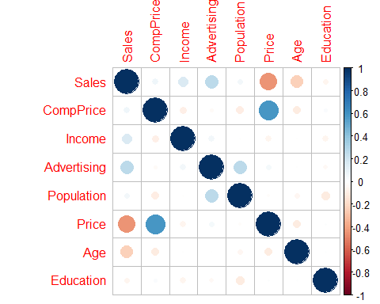
Example
library(ISLR)
library(corrplot)
library(dplyr)
Carseats_num<- Carseats %>% select(-one_of("ShelveLoc","Urban","US")) corrplot(cor(Carseats_num))
Notes:
Here we can see the correlation plot of all the numerical variables in the car seat data frame. In order to compile the correlation metrics, we first need to select the numerical variables in the car seat data frame. To do that, we pass the car seat data frame to the select function and we identify the variables of interest. In this case we need all variables except for “shelvloc,” “Urban” and “US.” And we can say “select minus one of ShelveLoc Urban US.” What the function does is to drop the particular variables we have indicated, and it will restore the rest of the variables data frame called carseats_num now we can calculate the correlation metrics for the carseats_num data frame and plot using the core plot function. The results are show in here as well. As we can see, on the diagonal, we have of correlation values equal to 1, which are color coated with dark blue because the correlation of each variable with its own would be 1. Also, as you might of noticed, the correlation metrics is shown to be symmetrical, because as we know the correlation of X and Y is equal to correlation of Y and X. We can also see some strong correlations, for example, there is a strong correlation between the price, and the competitor price. Also, we can see a strong negative correlation between price and sales; generally the higher the price, the lower the sale.

Slide 13
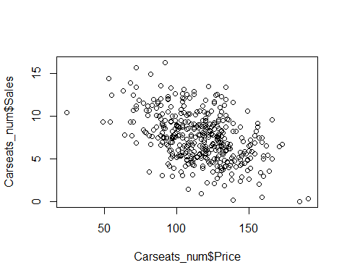
Example
plot(Carseats_num$Price, Carseats_num$Sales) #or with(Carseats_num,plot(Price,Sales))
Notes:
We can also use a scatterplot to see the relationships between 2 variables. In this case we are interested in seeing the relationship between the price and the sales. So the plot function can be used to show the scatterplots. In this case the first argument would be the axis and the second argument would be the y axis. So in this case we have plot Carseat_num$Price comma Carseats_num$sales. As you can see the growth already shows a negative correlation between the 2 variables. So the data points are plotted individually, and a general negative trend ca be spotted from the figure.

Slide 14
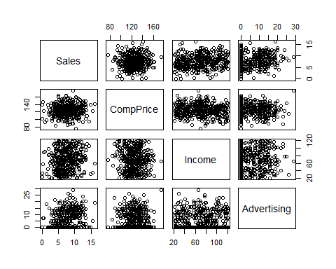
Example
pairs(Carseats_num)
Notes:
The pairs function can be used to show the scatterplots for every pair of the numerical and categorical variables in the data frame. In this case, the plot shows the relationship between sales, competitor price, income and advertising. The pairs function is specifically useful to spot potential trends that might exist in the data frame.

Slide 15
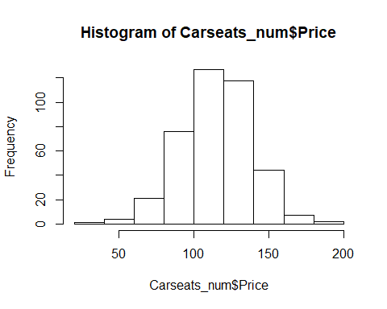
Example
hist(Carseats_num$Price)
Notes:
Histogram can be created using the hist() function in R. This function takes in a vector of values for which the histogram is plotted.
The frequency distribution histogram is plotted vertically as a chart with bars that represent numbers of observations within certain ranges of values.

Slide 16
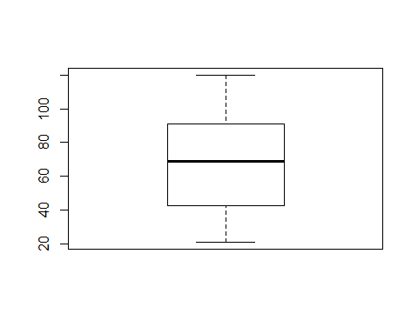
Example
boxplot(Carseats_num$Income)
Notes:
Finally, the boxplot function can be use to create the box plot of a numeric vector.
A Box Plot is the visual representation of the statistical summary of a given data set including the min, max, median and the 1st and 3rd quartiles.

Slide 17
“By visualizing information, we turn it into a landscape that you can explore with your eyes. A sort of information map. And when you’re lost in information, an information map is kind of useful.” – David McCandless
In predictive analytics, various algorithms are deployed to mine data to find patterns with the goal making predictions.
Predictive analytics systems deploy more complex algorithms and are more computationally intensive
In Predictive Analytics systems the focus is in predicting the future as opposed to describing what has happened in the past which is the focous of BI systems.
Notes:
Pause for 10 seconds

